Slide 1
Adaptive features
IGCSE Biology

Slide 2
Key Definitions
Adaptation-the process, resulting from natural selection, by which populations become more suited to their environment over many generations
Adaptive features- an inherited feature that helps an organism to survive and reproduce in its environment.
Fitness- the probability/ chances of an organism surviving and reproducing in the environment

Slide 3
Adaptive features
This is any inheritable trait that increases it’s survival rate so that it can live longer, reproduce longer, and have more offspring (that also have that trait).
Adaptive traits can improve an animal‘s ability to find food, make a safer home, escape predators, survive cold or heat or lack of water, and so on.

Slide 4
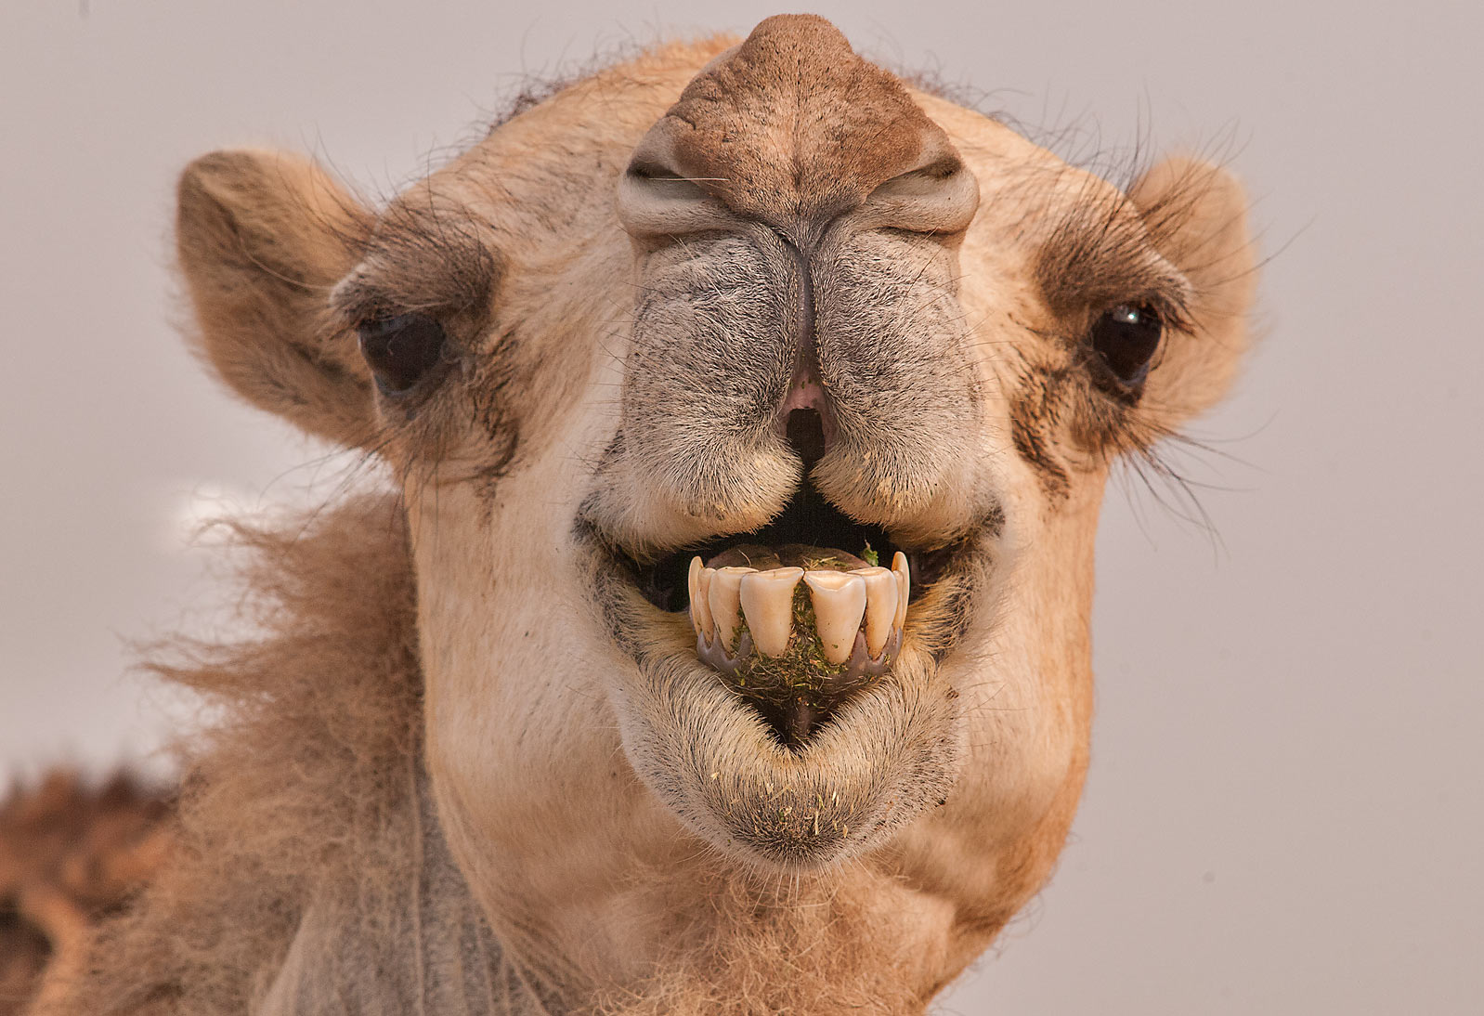
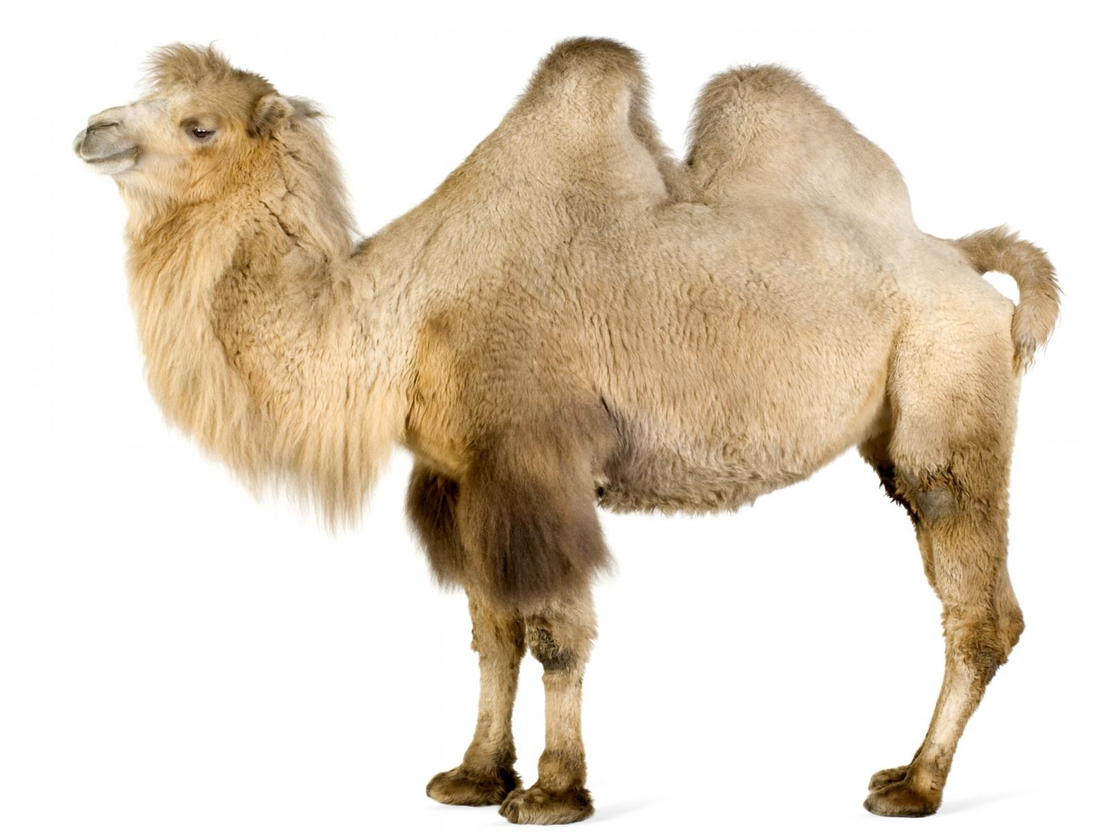
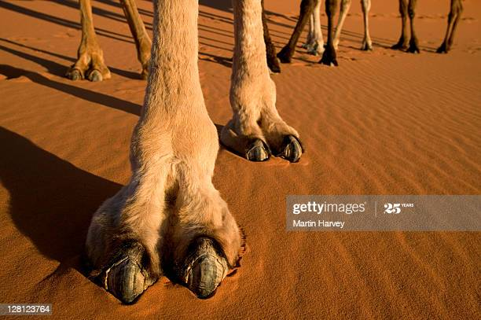
thin, slit, closable nostrils & two rows of eyelashes;
Large/ wide, flat/ padded feet;
Fat filled hump(s;
Can withstand water loss (no water for 1 week) & drink huge amount of water;
body temperature fluctuates (changes) throughout the day from 34°C to 41.7°C
Notes:
ruminant

Slide 5
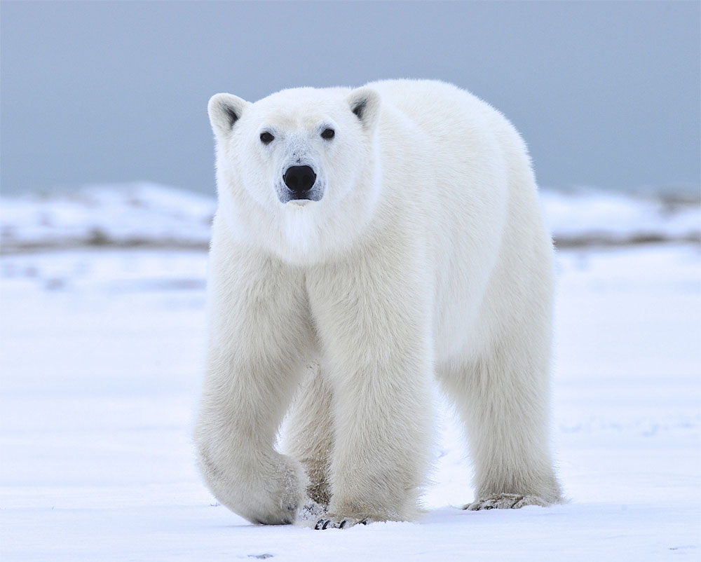
https://www.nationalgeographic.com/animals/mammals/p/polar-bear/
https://seaworld.org/animals/all-about/polar-bear/adaptations/
White appearance;
thick layers of fat (blubber) and fur;
Small ear & tail, a small surface area to volume ratio;
a greasy coat that sheds water after swimming;
Large, furry feet;
eat a very high fat diet;
Black skin;
Notes:
Their white fur helps them blend in with the snow and ice. When a polar bear swims under water it closes it nostrils so no water can get in
They also are one of the only bears that have a totally carnivorous diet. This means that they eat only meat. Most bears are omnivores and do eat plant matter. But where polar bears live, there is almost no plant matter available, so they have adapted a totally carnivorous lifestyle. Their long, sharp claws help them pull seals right out of the water when they surface to breathe and onto the ice where the bears can feed..
Polar bears move slowly and rest often to avoid overheating.

Slide 6
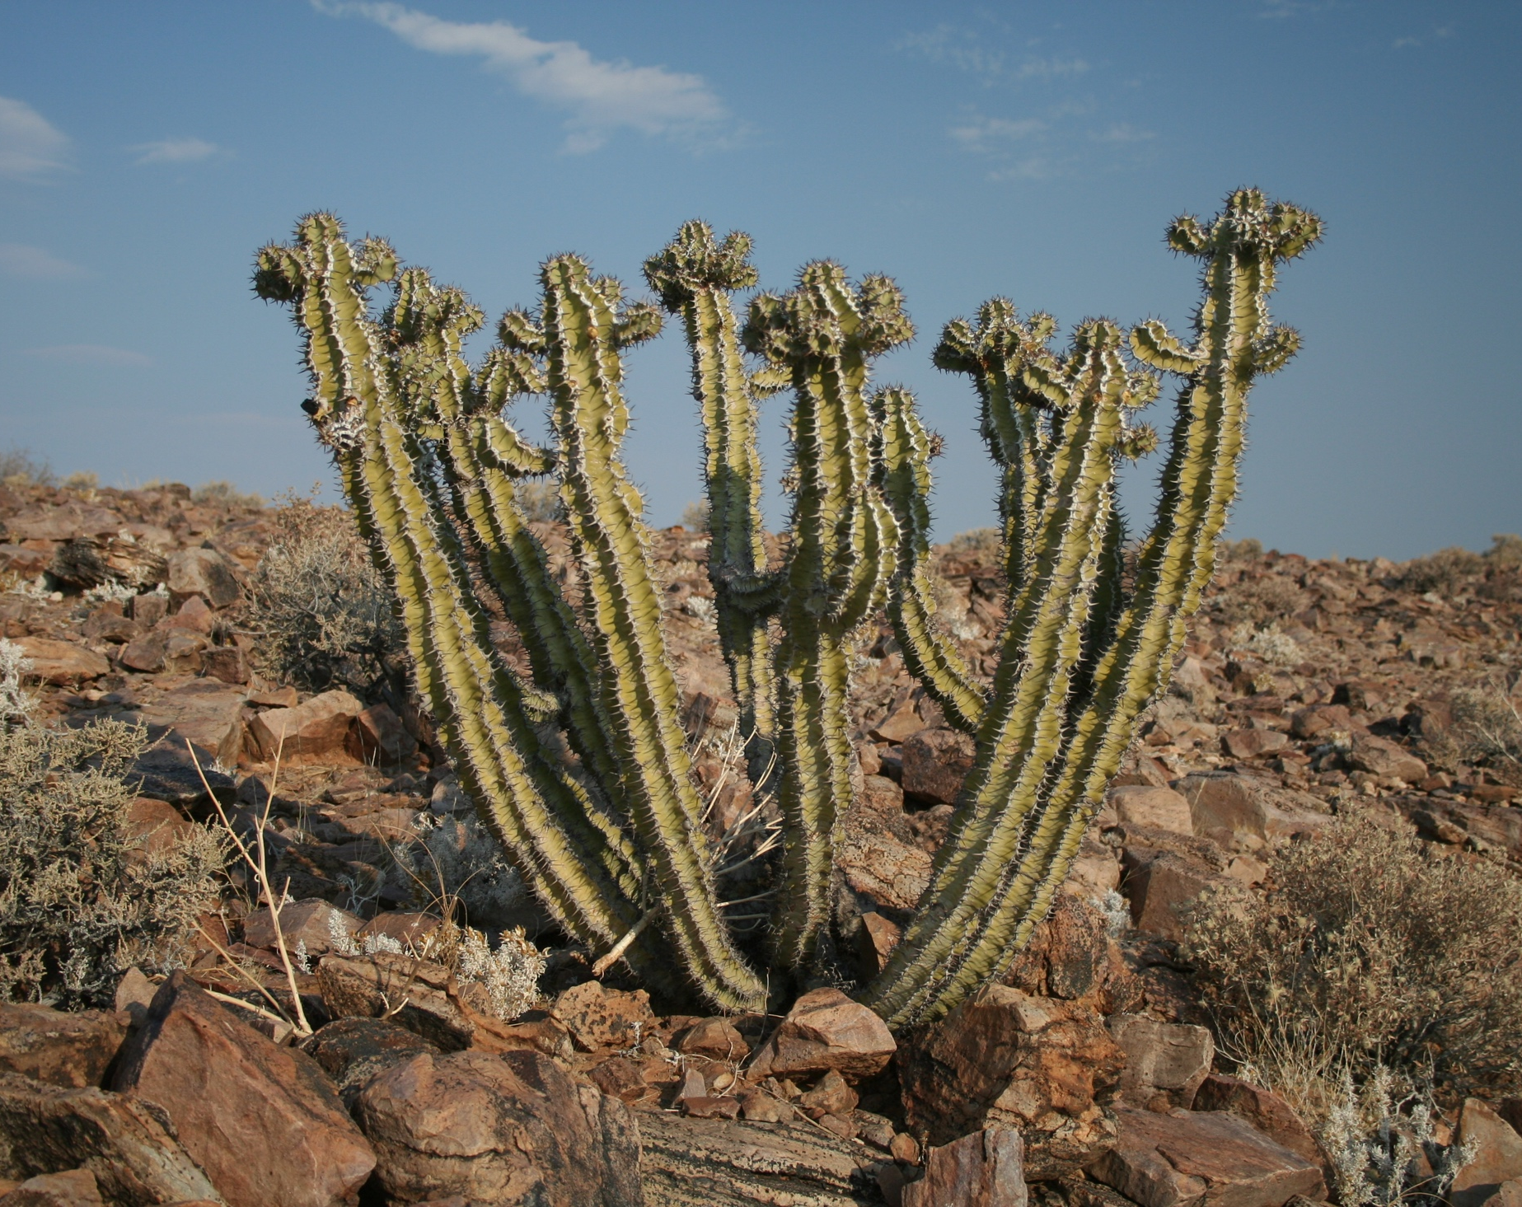
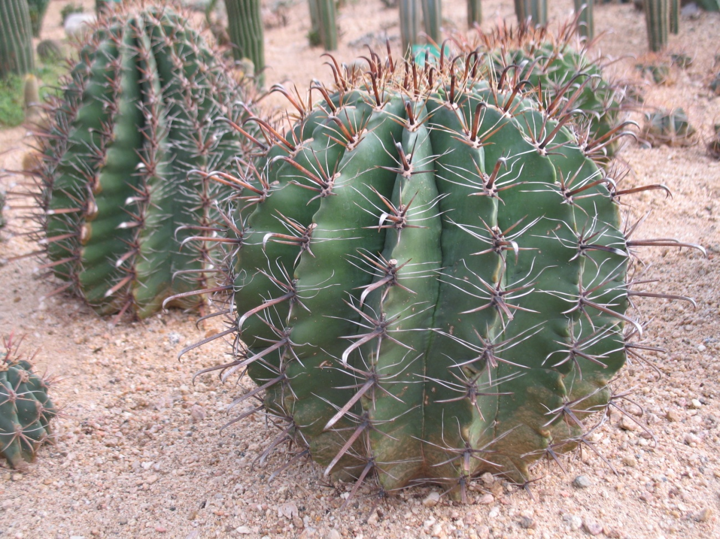
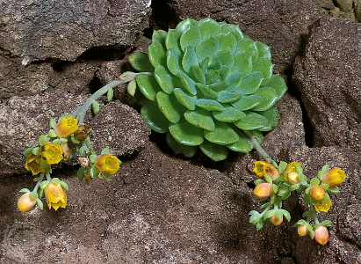
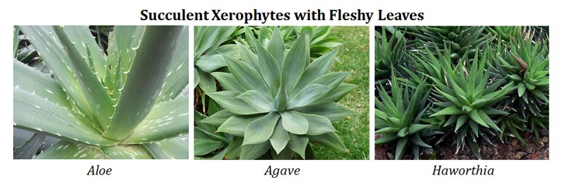
xerophytes
https://www.ck12.org/biology/xerophytes/lesson/xerophytes-advanced-bio-adv/

Slide 7
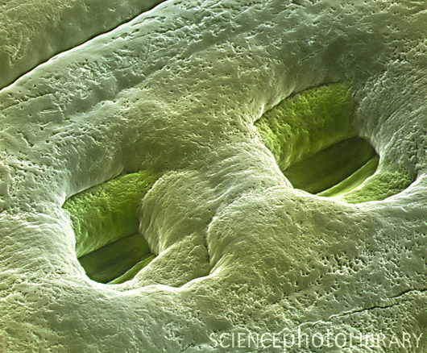
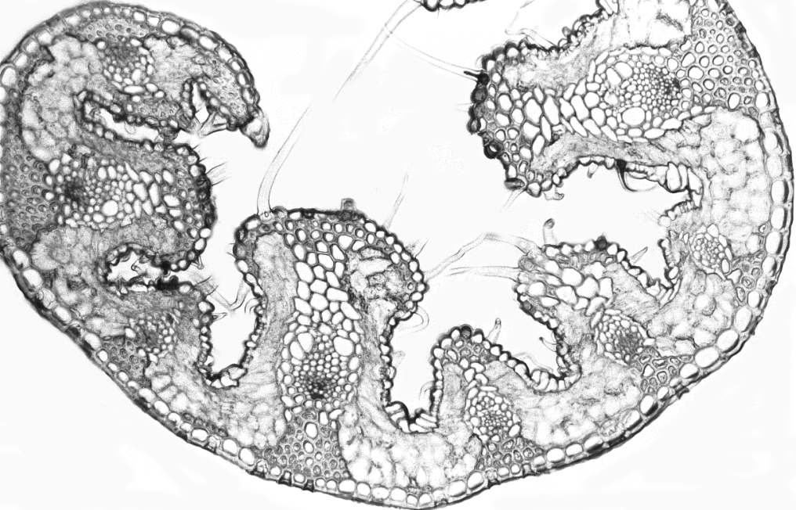
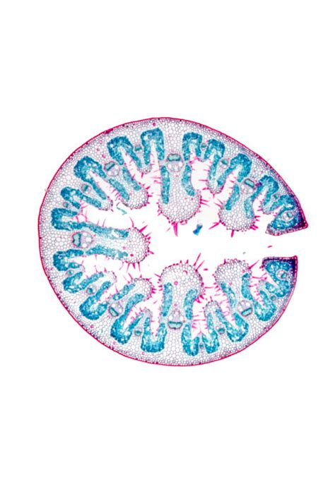

Slide 8
xerophytes
spine, needle or small leaves
thick, waxy cuticle
thick, green, swollen stem
shallow, spreading roots OR very long roots
rolled, hairy leaves
sunken stomata
stomata may close at daytime
https://biology-igcse.weebly.com/adaptations-of-the-leaf-stem-and-root-to-different-environments.html
Notes:
This sunken stomata condition found in leaves of succulent xerophytes (hot desert plants) facing high temperature condition and gymnosperms. Some plants with SUNKEN STOMATA are Nerium, Pine, Acacia, etc. Plants growing mostly in xerophytic conditions have sunken stomata where they need to reduce transpiration rate. For e.g. Pinus , dracaena , yucca, opuntia etc.

Slide 9
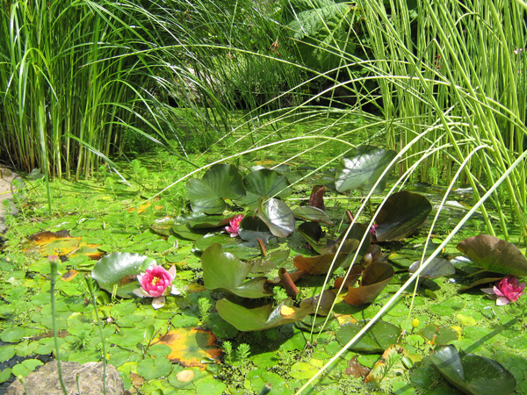
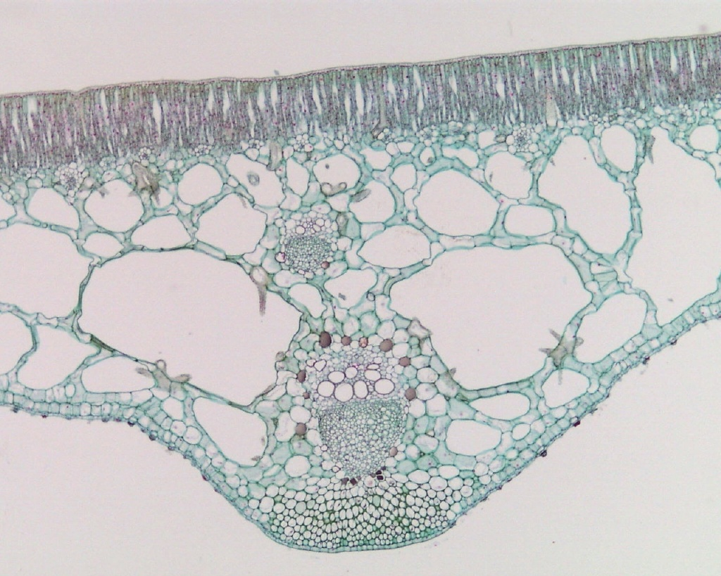
hydrophytes
Air space

Slide 10
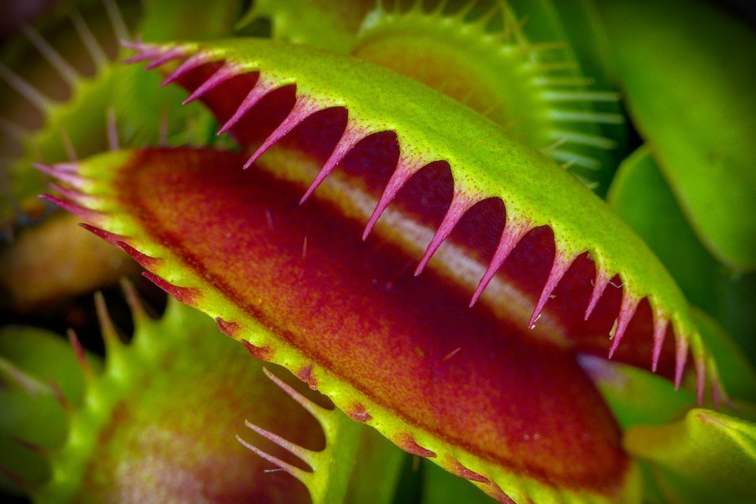
Venus flytrap

Slide 11
Definition
Adaptation-the process, resulting from natural selection, by which populations become more suited to their environment over many generations
Evolution-the change in adaptive features of a population over time as a result of natural selection
Natural selection- greater chance of passing on genes by the best-adapted organism.
Adaptive features- an inherited feature that helps an organism to survive and reproduce in its environment.
Fitness- the probability/ chances of an organism surviving and reproducing in the environment

